Slide 1

Drupal in Johnson & Johnson
May 13th, 2016
Alan Webb, Digital Software Manager

Slide 2





Drupal Landscape
1800+ Drupal websites across the organisation
Consumer
Pharmaceuticals
Medical Devices

Slide 3

Challenges
Large amount of build vendors
Large amount of creative agencies
Large amount of hosting environments

Slide 4


Solution
Create a single platform product for each sector which meets their needs
For each sector:
All sites on the same version of Drupal
All sites on the same Drupal distribution
All sites in the same hosting environment

Slide 5









Reducing Complexity in J&J Consumer
Our Old Approach - Website Build Projects
Current State – Digital Product Development
Brand creative agencies design sites ‘from scratch’ which are developed by a limited set of build partners, resulting in costly, hard to maintain sites
Brand creative agencies utilize and evolve a design framework and have sites built on the platform by internal J&J teams augmented by trained partners
Limited Build
Partners
100+ Creative Agencies
Proliferation of
Platform & Hosting Solutions
With sub-optimal learning
J&J Build Teams /
Trained Build
Partners
Hosted on Acquia
Trained Creative
Agencies
70 Hosting Envs.
Notes:
with suboptimal user experience.
Canvas is 9 months old.

Slide 6

Meet CANVAS
CANVAS is a website platform enabling brands to create premium owned digital experiences for our consumers faster than ever, and with access to today’s best in class user experience, features and toolsets.

Slide 7
What is Canvas?
Drupal multi-site environment
Pre-defined set of Content Types
Pre-defined set of CANVAS features
Provides standard CANVAS theming

Slide 8
Out of the box…
Multi-lingual (Bi-directional)
Large Feature Set
Responsive
Canvas Theming
Base Theme: Base Theme Link
Brand Theme: https://www.regaine.co.uk/
Best in class user experience

Slide 9
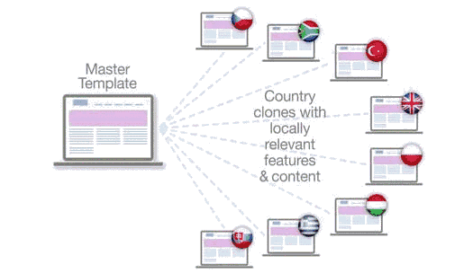
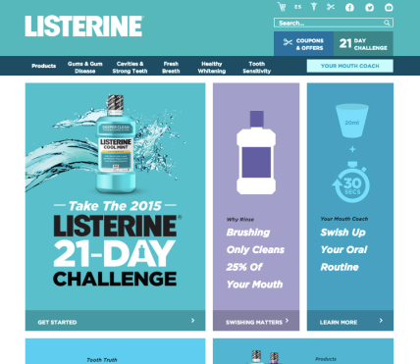
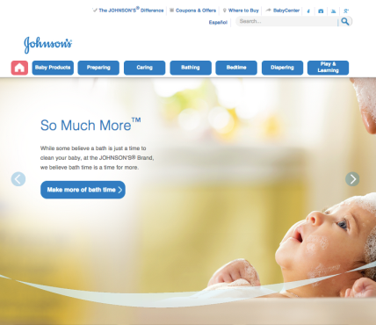
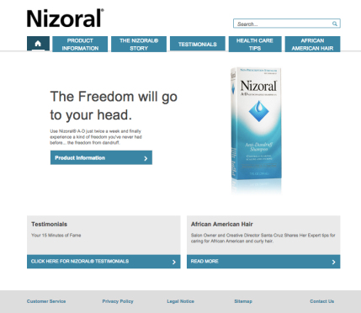
Global “Local” Websites
A global ‘Template’ that enables:
Locally relevant content
Local control of navigation
Localized standard features
Multilingual support
Multi-Domain Support

Slide 10
Customizing Canvas | Flexible Build & Run Options
Specific options may differ per site. Specs are reviewed by project teams to determine customization needs, and impact to cost and scope.
STANDARD SUPPORT
EXTRA SUPPORT
Platform Layer
$
$$$$
OPTION 1
OPTION 2
OPTION 3
OPTION 4
Content
CMS editor
Basic Look/CSS
Certified Drupal Site Builder handles initial build from Canvas toolkit designs
Certified Front-end Specialist
required (most creative/digital agencies can qualify)
Front End
Flexible Page Layouts
Advanced CSS
Custom Fonts
Basic Functionality Overrides
Certified Drupal Site Builder required
JavaScript
Certified Drupal Platform Developer required (select partners with Drupal specialty)
Site Theme
Custom Modules & Content Types
Registration/Sign-In Look/Feel
Analytics
OS Product/Back End
User Forms
Dedicated certified team required. Ex:
• Scrum master
• Tech Lead
• Front-end dev.
• Site builder
• QA analyst
• DevOps Lead
Omega 4/JJ Base Theme
SEO (features, not values)
Registration/User Data Management
OS Core Modules & Services
OS Content Types
CMS & Publishing Workflow
Multi-Site Deployment
Platform
Drupal Core
Acquia Cloud Subscription
Recommended use cases
Clones, local brands, master templates
Mega brand/Lead markets
In all models, a new Canvas site is first built by a certified Drupal Site Builder. Once a site theme exists, a Front-end Specialist may handle any added styles or page layouts.
Open
Open with
restrictions
Locked | See next slide for layer definitions
Notes:
You

Slide 11



CANVAS by the Numbers
3
199
1350+
J&J Contributed Modules with
reported installs…
so far
1000+
Collaborators in Jira
2,400+
50%
70
User Stories Completed
Decrease in site
time to market
CANVAS Sites
Launched
797K
(103k custom code)
200
59%
Decreased site development costs
Sites by
year end
Total lines of code
Notes:
This is the total lines of code in all custom, contrib, features, and theme files - excluding Drupal core.
3 modules contributed to the Drupal Community
Workbench Scheduler: https://www.drupal.org/project/workbench_scheduler
Apachesolr Reference: https://www.drupal.org/project/apachesolr_reference
MetaTag Custom (Sandbox): https://www.drupal.org/sandbox/mikemiles86/2118981
Total modules in the platform
Number of custom modules
Contrib : 107
Custom: 31
Features: 61
total: 199
Lines of custom code (used to be 34,296)
1,257,482 lines of code (not including core)

Slide 12




Goals and Guiding Principles
Keep Global Brand sites upgraded
Enable seamless operation
Define “True Canvas”
Production feedback loop

Slide 13
Drupal in the EDC
One Team Currently working with CANVAS
Working on:
New Feature Requests for CANVAS
Master Template Sites
Clones
Second Team being spun up to work on the Pharmaceutical Platform FUSION

Slide 14
Questions... ?

